Slide 1
Live Session 3
Experimental Statistics 2

Slide 2
Bias Variance Trade OFF
Scenario 1 - Low complexity.
High Bias/Low Variance

Slide 3
Bias-Variance Trade Off
Scenario 2 - Low complexity.
Moderate Bias/Low Variance

Slide 4
Bias-Variance Trade Off
Scenario 3 - Low complexity.
No Bias , Low Variance

Slide 5
Bias-Variance Trade Off Overfitting with K Nearest Neighbors (k=5)
Scenario 4 - High Complexity.
No Bias, Moderately high Variance

Slide 6
Bias-Variance Trade Off Overfitting with K Nearest Neighbors K=2
Scenario 5 - High Complexity ( Even more overfitting).
No Bias, Higher Variance

Slide 7
Bias Variance Trade off
Bias
High Moderate None None None
Low Low Low Moderate High
Variance

Slide 8
Why Centering Predictors can help with Multicollinearity
Consider adding a squared term to a regression model.
The function of the parabola is more linear the farther you get away from the inflection point
Centering data first creates a ”flat balance” so the correlation between the two is weaker.

Slide 9
Centering doesn’t Fix the problem for Cubic or any other Odd polynomial
The function is still always increasing so we will have an increasing relationship that the correlation metric captures.
In R, the “poly” function can be used to constructed higher order terms so that they are mathematically uncorrelated.
As with all of these fixes (centering, poly in R), it can be harder on interpretation depending on what terms are included.

Slide 10
What does it mean to “adjust” for a covariate/predictor?
Estimate Std. Error Pr(>|t|) (Intercept) 16.2697 0.3792 < 2e-16 ConditionSick 4.3298 0.6409 5.28e-08
Fun Fact: Simple regression such as this is the same as the pooled t-test.
Clearly, higher response values are driven by Age.

Slide 11
Age is Correlated to the RESPONSE

Slide 12
“Adjusting the Analysis for Age”
Coefficients:
Estimate Std. Error t value Pr(>|t|)
(Intercept) 9.23183 0.70419 13.110 1.77e-15
ConditionSick -0.67452 0.58248 -1.158 0.254
Age 0.34777 0.03345 10.397 1.57e-12
We can no longer claim a difference in the 2 conditions after adjusting for the Age effect.

Slide 13
Residuals As a new Response
Suppose we fit a model with just age, and then plot the residuals versus the conditions. This is effectively what is left of the response after eliminating the Age trend.

Slide 14
Rest Assured if there was a difference we would still see it
I simulated that data set so there was no difference in conditions.
In case you are concerned that adjusting for age will never allow you to see a difference in the conditions. I will show another example.
The true difference between the two condition is going to be 5. Lets compare the estimated difference using a pooled t-test and then adjusting for Age and see how it comes out.

Slide 15
New Data Set
Note here that all the older observations are in the healthy group and all of the Sick are younger

Slide 16
Comparison

Slide 17
A High Level View
Key assumptions:
Normality of residuals
Constant variance

Slide 18
Main Effect (Additive) versus Interaction (NonAdditive)
Section 13.2 is a good read for this
Main Effect (Additive) Example
Change in the treatment does not depend on what Factor 1 is
It interprets the same way for Factor 1. Changes in Factor 1 BvsA does not depend on what Factor 2 is
 | Factor 2 |  | Effect
Factor 1 | Trt1 | Trt2 | (aka diff)
A | 78 | 70 | 8
B | 85 | 77 | 8
C | 79 | 71 | 8
D | 89 | 81 | 8

Slide 19
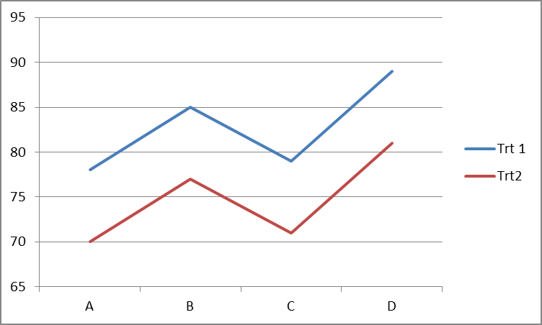
Main Effect Visualization with Profile plots
Additive Model Plots will be roughly parallel
Again indicating the changes between one factor’s levels does not depend on what level you are at for the other factor

Slide 20
Main Effect (Additive) versus Interaction (NonAdditive)
Interaction Effect (NonAdditive) Example
Change in the treatment depend on what Factor 1 is
It interprets the same way for Factor 1. Changes in Factor 1 BvsA depends on what Factor 2 is
 | Factor 2 |  | Effect
Factor 1 | Trt1 | Trt2 | (aka diff)
A | 71 | 71 | 0
B | 73 | 69 | 4
C | 77 | 70 | 7
D | 83 | 72 | 11

Slide 21
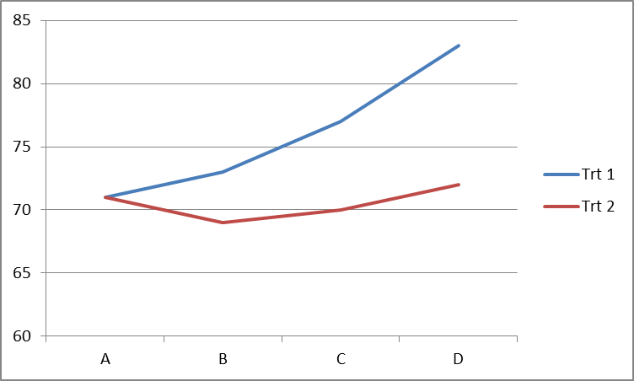
Interaction Effect Visualization with Profile plots
Nonadditive Model Plots will not be parallel
There are many different patterns when it comes to interactions, some special cases have specific meaning

Slide 22
Thinking about main effects if Interaction is present

Slide 23
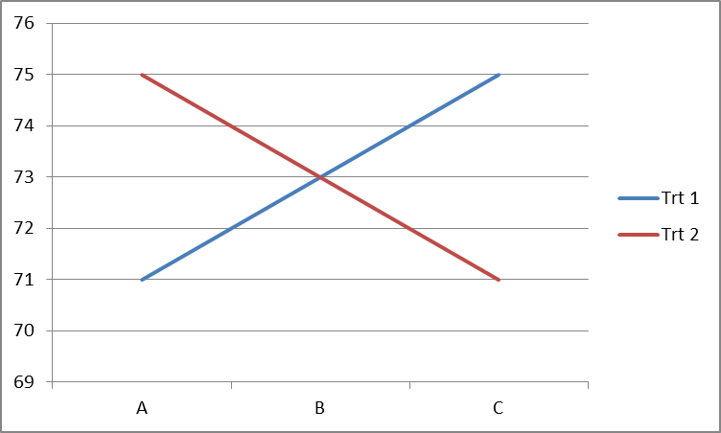
Significant interact but no main effect

Slide 24
Two way ANOVA (Basic Flow)
What situation are we in?
One Factor of interest with a Block
Randomized Complete Block Design
Two Factors
Both Factors are of interest
Plot data (visualize through mean profile plotting)
Fit full saturated model with both factors and the interaction (nonadditive) term
Diagnostics
Residuals
Normality, Independence, Constant Variance
Outliers (Don’t concern with leverage as these apply more to continuous explanatory variables)
Testing
High level (ANOVA)
Contrasts
If nonaddtive (interaction) is significant then we reports differences of groups by factor levels
If not significant, we compare contrasts of the individual factor levels (very simple -> very complex)
Both situations call for multiple testing corrections

Slide 25
Mean Profile Plotting
Good for visually assessing if an interaction exists
In real data, due to variability, it can be hard to tell
Plotting the raw points(or SD bars) in addition to the mean can help you assess right off the bat if the assumption of non constant variance is appropriate
Now, we can go ahead and fit the full nonadditive model and do some diagnostics and hopefully some testing.
Proc GLM
Model Y= FactorA FactorB FactorA*FactorB;

Slide 26
MEAN PROFILE PLOTTING (SD’s or SE’s)
Standard errors (Error bars):
Gives us a sense of uncertainty in the mean estimates for each group
CANNOT assess constant variance unless sample sizes are equal
Standard errors (Error bars):
Gives us a sense of the population variability
CAN assess constant variance

Slide 27
Fitting the Nonadditive Model
Fit the nonadditive model
Residual Diagnostics
Constant Variance, Normally distributed errors
Assuming all of that looks okay we need to examine if there is an interaction effect using the ANOVA table
If so, then we know changes depend on the level combinations so we will use contrasts to check them out
If not, we have two options
Refit the data without the interaction term
Perform main effect test from the Additive ANOVA table
Perform the main effects test from the full ANOVA table
For whatever effect has a significant F-test, we still don’t know which ones are different. Contrasts can be used to perform particular comparison or all possible pairwise tests

Slide 28
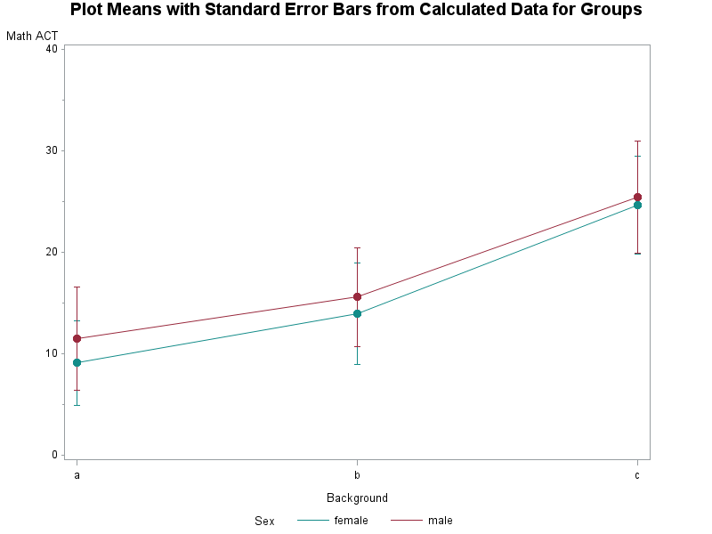
Example #1 Two Factors of Interest
Exercise 13.20
Assess the effects of ACT Math scores based on gender and mathematical background

Slide 29
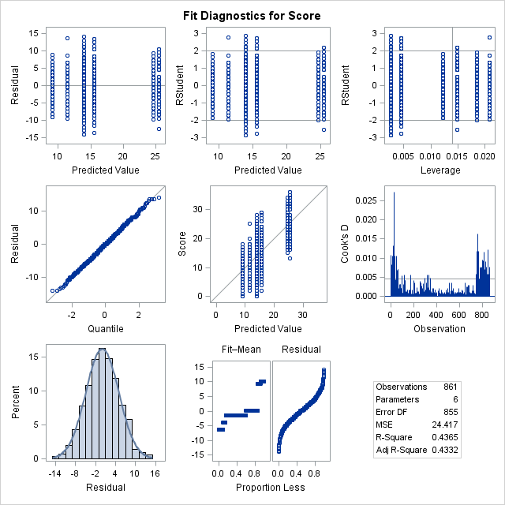
Fitting the Nonadditive and Residual Diagnostics

Slide 30
Provided R scripts Residual Diagnostics

Slide 31
Note about residuals
If all of your residuals are 0, and the interaction F-test is missing from your ANOVA table.
This is because you do not have any replicate observations at the interaction levels.
Example
Can assess interaction Can not assess interaction

Slide 32
ANOVA (High level Ftests)
Overall F-test can be used to see if there are any difference. (just like last weeks discussion )
Additional F-tests can tell us something about each factor and if a nonadditive model (Sex*Background) is supported (Use type-III !!!)
Reminder: These tests don’t tell us which specific groups or combination of groups are different from each other

Slide 33
Contrasts
Contrasts were a little bit confusing when using the Seaweed grazer study. There are a few complexities here that are somewhat hidden from the student
Simple idea:
Once an overall F-test is conducted and found significant and if the factor of interest has more than two levels, we would like to know which factor levels are different
Contrasts allow us to do this

Slide 34
Contrasts
Since background is significant, we would like to know which mathematical backgrounds were different from each other. One comparison to make is B vs A (no reason why it can’t be A vs B)
IN SAS
estimate 'B vs A' background -1 1 0;
Estimate “Name” Factor of interest (Seq of # to get difference))
SAS knows the order by alphabetical so background is A B C
To test for BvsA -1 1 0 -1*A+1*B+0*C= B-A

Slide 35
COntrasts
For background, there are 3 total tests to get at
BvsA
CvsA
CvsB
Anytime we start conducting multiple tests that we didn’t plan for in advanced, we need to make sure we are not too optimistic with our testing, so we adjust the pvalues using various procedures
Bonferroni
Tukey
Dunnett

Slide 36
COntrasts
For background, there are 3 total tests to get at
BvsA
CvsA
CvsB
Rather than write out 3 contrasts we can tell SAS to do them all with one option
lsmeans background / pdiff tdiff adjust=bon;
If we wanted both background and sex, we would just add it
Lsmeans background sex / pdiff tdiff adjust=bon

Slide 37
All comparison using Pdiff option

Slide 38
Pdiff in Proc Mixed
Suggestion for ease in contrasts…..switch to proc mixed
proc mixed data=math PLOTS=(RESIDUALPANEL);
class sex background;
model score= background sex background*sex;
lsmeans background sex / pdiff tdiff CL adjust=bon;
run;

Slide 39
What if there was an interaction
If the interaction F tests is significant, we know that the difference between levels of 1 factors depends on the levels of the other factor.
In this situations, even if the “Main effects” are significant we do not need to explore them because of the interaction effect
Using SAS to do all the comparisons for us.
Lsmeans Background*Sex / pdiff tdiff adjust=Tukey;

Slide 40
What if there was an interaction
Using the hard coding (the caveat here is that multiple testing corrections are not applied)
Estimate “M vs F for Background A” Sex -1 1 Sex*Background -1 0 0 1 0 0;
A*B Levels of B by levels of A
Contrasts Order:
Afemale Bfemale Cfemale Amale Bmale Cmale
-1 0 0 1 0 0

Slide 41
So what about if there is only one factor of interest when one is a blocking variable?
Nothing really changes.
In a lot of cases, blocks are generally assumed to have no interaction with the factor of interest (through randomization and design)
No interaction term is included
Simply look at the F-test for the variable of interest and dive in with contrasts
With adequate sample sizes, it doesn’t hurt to assess if there is an interaction

Slide 42
What makes The Seaweed grazer study more difficult to understand what is going on with the contrasts?
In a perfect world with no restrictions we would have more than two way anova.
Limpets (yes or no)
Small fish (yes or no)
Large fish (yes or no)
Control is all no
With enough sample size and all of the factor level combinations, we could include all of the two way and three way interaction and conduct a similar analysis for three way anova as we have discussed for two way anova
Problem is we can’t observe every combination due to the study design and the logistics of the netting. So we simply reduced the levels of the combinations that we could get and put them in a single factor
The second factor was then a blocking variable.

Slide 43
What To take away from NEXT Week Videos
Why is important to handle data collected over time differently
How log transforming the data can help time series data
Two Main Scenarios
One sample t-test situation
Correlations of pairs of data/ Multiple regression**
Do not worry about the “filtering approaches”.
We will focus on the Generalized least squares approach which will be very similar to what you already know about SAS and multiple regression
Make note: like all regression techniques, the focus is going to be on using the residuals (its always about residuals!!!)
Try to get a feel for what to look for in the ACF and PACF plots 4.9

